Slide 1
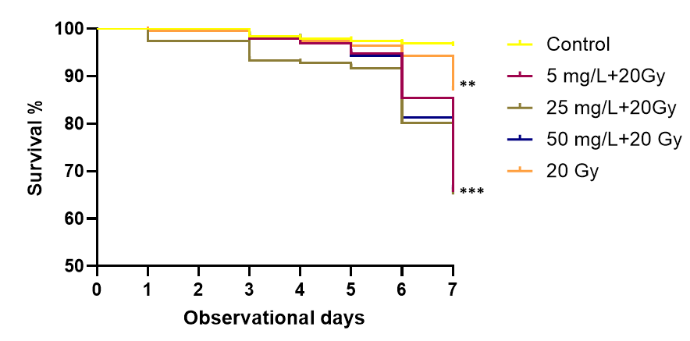
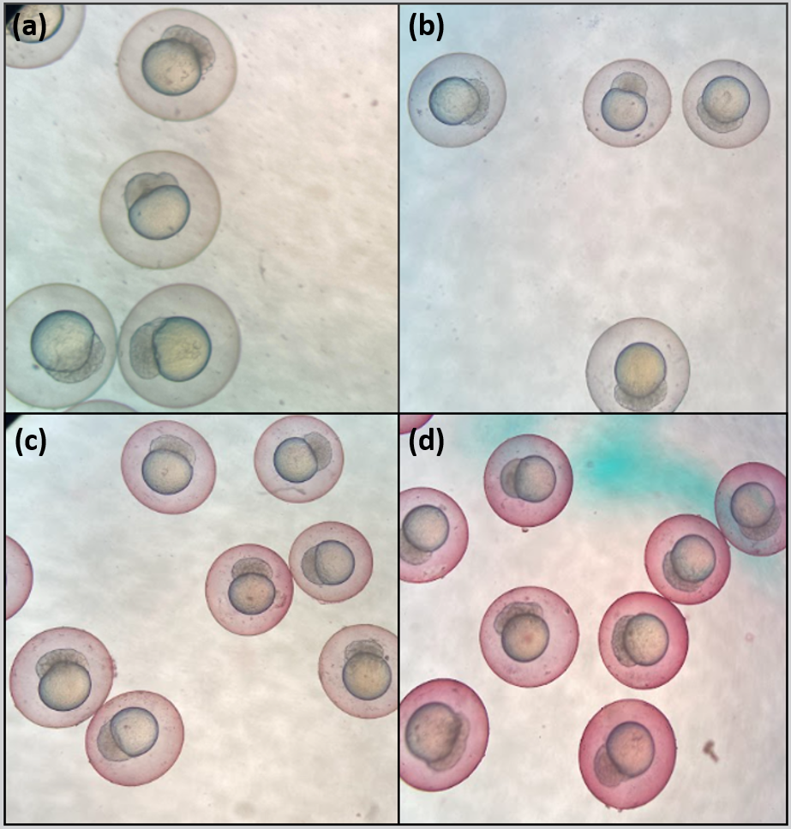
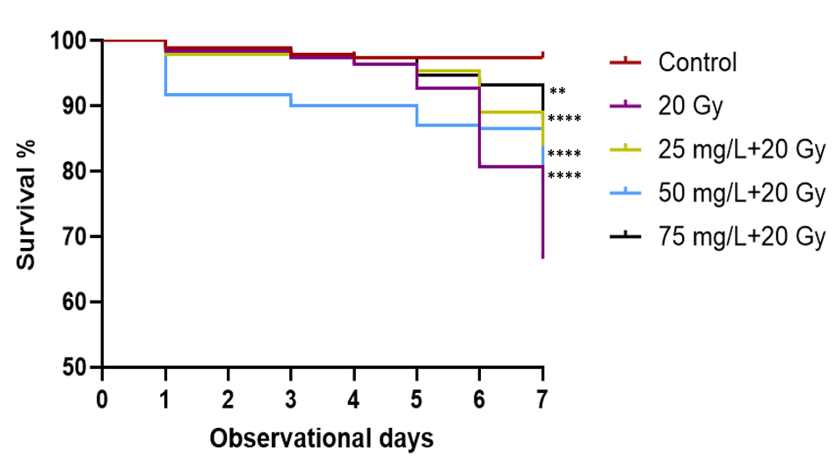
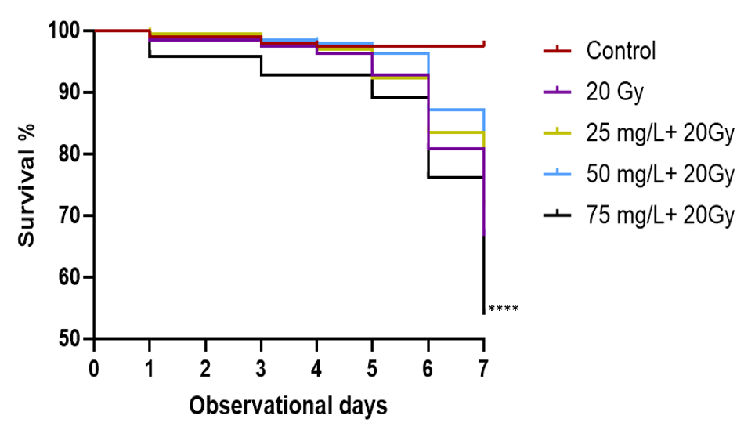
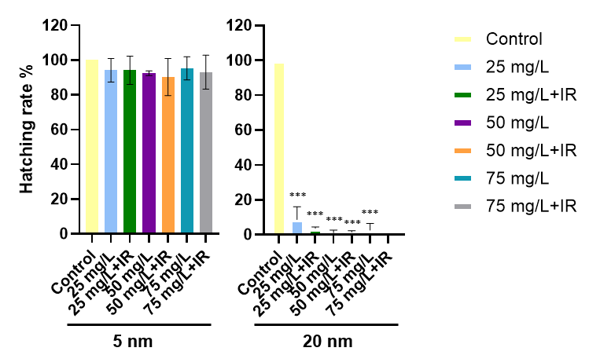
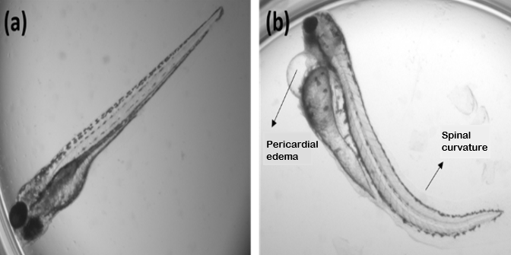
Toxicity and radiation-modifying effects of nanoparticles on zebrafish (Danio rerio) embryo
¹Rita Júlia Dudás, ¹Ébert Attila, ¹Károly Mogyorósi, ²Mónika Kiricsi, ²Nóra Igaz, ¹Réka Molnár, ¹Róbert Polanek, ^{1,3}Katalin Hideghéty, ¹Emília Rita Szabó
¹The Extreme Light Infrastructure ERIC, ALPS Facility, Szeged, Hungary
²University of Szeged, Faculty of Science and Informatics, Department of Biochemistry and Molecular Biology, Szeged, Hungary
³Oncotherapy Department, University of Szeged, Szeged, Hungary
INTRODUCTION/AiM
 | Gold nanoparticles (AuNP) | Platinum nanoparticles (PtNP) | Hafnium nanoparticles (HfO₂NP)
Size | ~13 , ~47 nm | ~5, ~20 nm | solution contained 55 - 75 nm particles
Concentrations | 5, 25, 50 mg/L | 25, 50, 75 mg/L | 10, 30 ug/mL
Nanoparticles (NPs) have proven to be effective in a variety of applications (e.g. delivery of therapeutic molecules, imaging, and radiosensitization). Recent advances in nanotechnology have also led to their emergence as new therapeutic agents in the field of radiation oncology.
Various metallic nanoparticles have been investigated to increase the radiosensitivity of cancer cells while simultaneously minimizing radiation toxicity in normal tissues.
The enhanced radiosensitivity of tumor cells treated with nanoparticles is well established, but little is known about their effects on healthy tissues which warrants further exploration.
The main aim of our research was to investigate the toxic effects and biodistribution of nanoparticles of different sizes (AuNP, PtNP, HfO₂NP) in a zebrafish embryo model. Our secondary objective was to examine the radiation-modifying capabilities of AuNP, PtNP, and HfO₂NP in normal tissues.
Table 1. Size and concentrations of the used nanoparticles
Figure 3. Effects of combined treatment with 47 nm AuNP on survival.** p < 0,05, *** p < 0,001 significant differences relative to the control group.
Figure 2. Embryos treated with different concentrations of 47 nm AuNP after incubation. (a) control group, (b) 25 mg/L, (c) 50 mg/L, (d) 75 mg/L
RESULTS
Figure 4. Effect of combined treatment with 5 nm PtNP on survival. ** p < 0,05, **** p <0,0001 significant differences relative to the control group .
METHODS AND MATERIALS
We found that AuNP at the concentrations used did not have significant effect on embryo development and mortality. 47 nm AuNP increased the effect of radiation independently from the concentration. The PtNP treatment was found to be toxic irrespective of size and enhanced the effects of radiation i.e. increased the number of dead individuals and the extent of morphological lesions. Furthermore, we found that PtNP affected the hatching rate of embryos compared to AuNP and HfO₂NP nanoparticles. In contrast, HfO₂NP showed no significant effect on survival and morphological abnormalities
24 hours post fertilization zebrafish embryos were exposed to nanoparticles of different concentrations and sizes. For toxicity measurements, the embryos were incubated for 24 h with AuNP (12 and 47 nm) at concentrations of 5, 25, 50 mg/L, PtNP (5 and 20 nm) at concentrations of 25, 50, 75 mg/L, and HfO₂NP (solution contained 55 - 75 nm particles) at 10 and 30 µg/mL. Following incubation, embryos were irradiated with 20 Gy photon dose (250 keV). Microscopic observations were carried out for 7 days after the treatments to study the hatching rate, viability and various morphological changes (e.g. pericardial edema, spine curvature) of the embryos.
Figure 5. Effect of combined treatment with 20 nm PtNP on survival. **** p < 0,0001 significant differences relative to the control group.
CONCLUSIONS
The observed radiosensitizing effect of AuNP and PtNP suggests that the particles have penetrated through the embryo chorion possibly by passive diffusion. AuNP and PtNP's toxicity raises concerns regarding its use in combination with radiation therapy while HfO₂NP show promise with relatively low radiation toxicity. Further research is needed to understand better the mechanisms underlying these effects and to optimize the use of nanoparticles in radiation oncology protocols.
Figure 6. The graph shows the hatching of 120-hour-old embryos that have undergone PtNP treatment and irradiation. *** p < 0,001 significant differences relative to the control group.
Figure 1. (a) Zebrafish larvae with a normal phenotype, (b) treated larvae with morphological abnormalities.
Contact
E-mail: julia.dudas@eli-alps.hu

