Slide 1

Medical exposure to ionizing radiation – the national results of monitoring in 2022
Olga Girjoaba
National Institute of Public Health

Slide 2
Introduction
Medical exposure is the most important anthropogenic source of population exposure to ionizing radiation, this aspect being emphasized countless times, internationally, by experts in protection against ionizing radiation.
The Romanian national legal framework harmonized with the Community provisions stipulate the obligation and responsibility of the public health network to ensure the radiological protection of the patient during the medical exposures to ionizing radiation.
The monitoring of medical exposures to ionizing radiation is based on data collected from Romanian hospitals in 2022, the results obtained at national level being useful in the process of optimization of radiological procedures for diagnostic and also for establishment and review of DRLs.

Slide 3

Reported system
Level 1
X-RAY
MAMMO
Hospital level
CT
HOSPITAL 1
HOSPITAL 2
HOSPITAL 3
Public Health Authority – county level
Level 2
Level 3
NATIONAL INSTITUTE OF PUBLIC HEALTH – national level

Slide 4
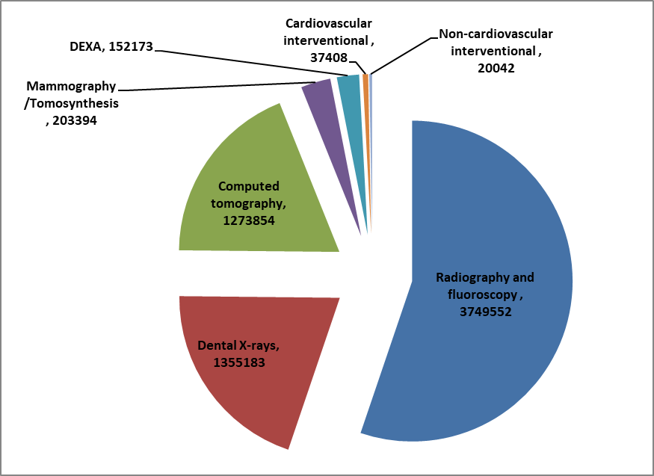
Results
In 2022, a number of 6.791.606 radiological procedures were reported:
3.749.552 radiography and fluoroscopy exams
203.394 mammography exams
1.273.854 CT exams
37.408 cardiovascular interventional procedures
20.042 non-cardiovascular interventional procedures
152.173 DEXA exams
1.355.183 dental X-rays
At the same time, 23.992 diagnostic nuclear medicine procedures were reported.
The number of radiological equipment, for which data on the medical exposure were reported, represents 38% of the total radiology equipment in use for the practice of diagnostic and interventional radiology, respectively 58% of the total nuclear medicine equipment.

Slide 5
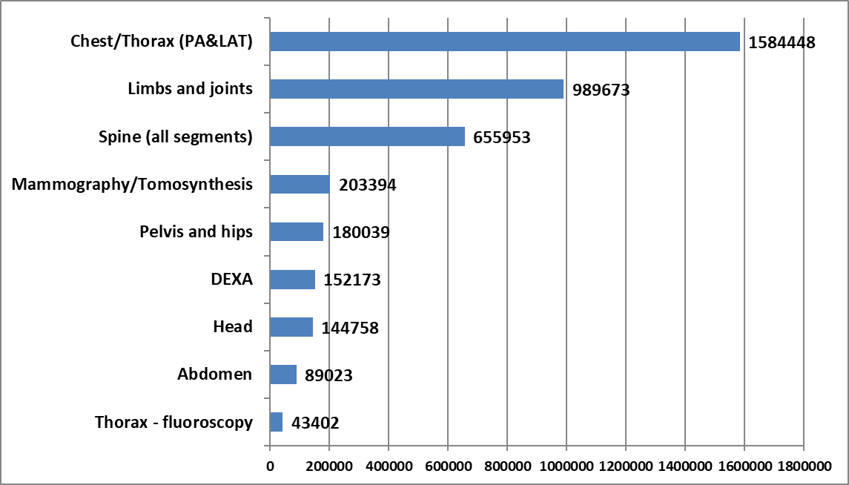
Results
At the national level, chest radiography remains the most frequent examination (38,6%) of all conventional radiological examinations, followed by radiography of the limbs and joints, spine – all sections, mammography, pelvis, skull and abdomen radiography and thoracic fluoroscopy exams.
Distribution of the most frequent radiography and fluoroscopy exams depending on the anatomical region

Slide 6
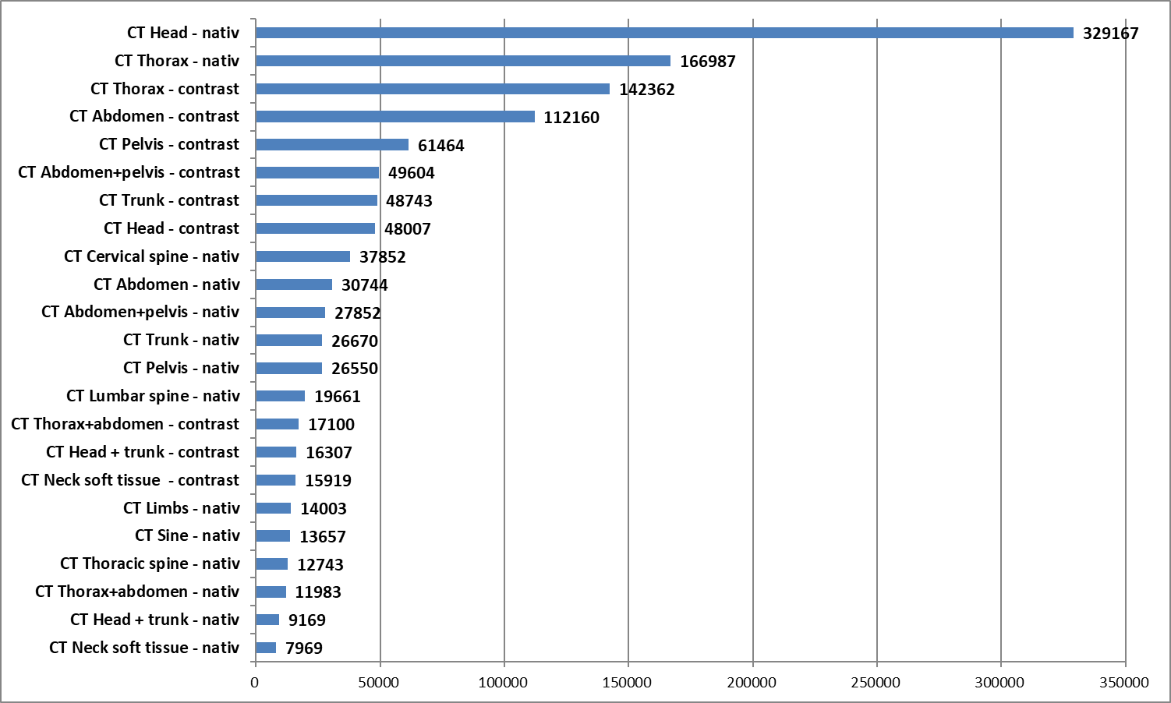
Results
The CT exams with the highest frequency are native scans of head region (29.5%), followed by both native scans and contrast scans of the chest/thorax (24.2%). Other common CT procedures are contrast scans of abdomen, pelvis, abdomen-pelvis region, trunk and head.
Distribution of the most frequent CT exams depending on the type of examination procedure (anatomical region investigated with / without contrast)

Slide 7
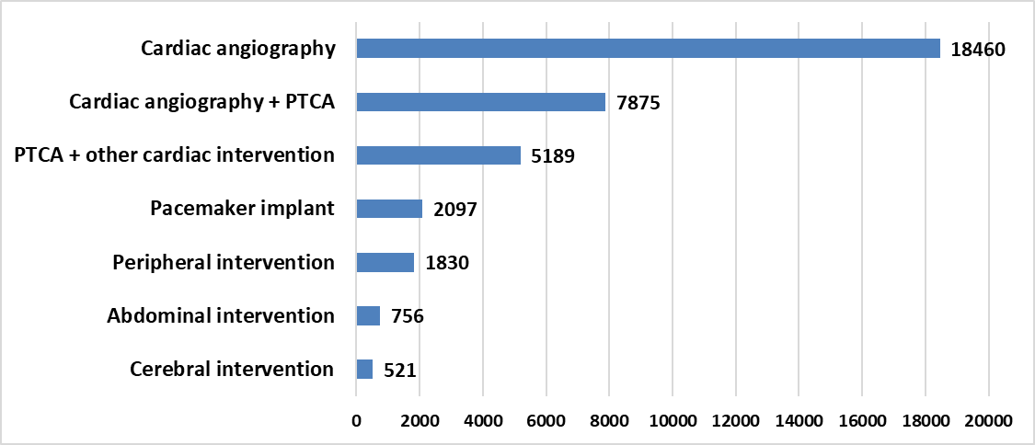
Results
For cardiovascular interventional radiology, the most frequent examination is cardiac angiography and for non-cardiovascular interventional radiology - the orthopedic procedures are very common.
Distribution of the most frequent cardiovascular interventional procedures

Slide 8
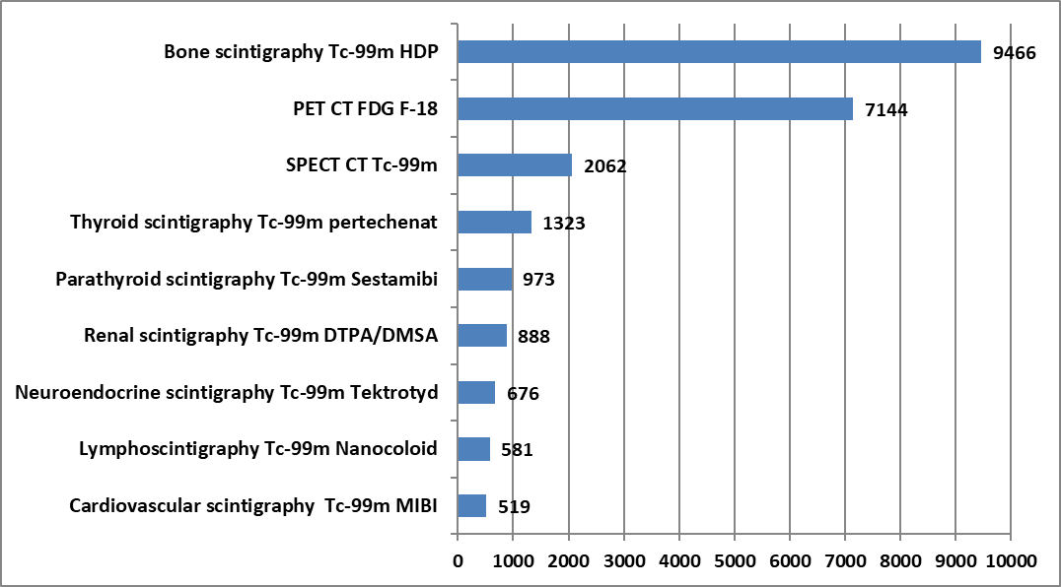
Results
In the top of nuclear medicine procedures are bone scintigraphy, followed by the PET-CT and SPECT-CT hybrid procedures, thyroid scintigraphy, parathyroid scintigraphy and renal scintigraphy
Distribution of the most frequent diagnostic nuclear medicine procedures

Slide 9
Results
Examination type | Effective dose (mSv) |  |  |  |  | The uncertainty (mSv)
 | 0-12 months | 1-4 years | 5-9 years | 10-14 years | ≥15 years | 0-12 months | 1-4 years | 5-9 years | 10-14 years | ≥15 years
Head AP/PA | 0.010 | 0.013 | 0.018 | 0.029 | 0.040 | 0.003 | 0.003 | 0.005 | 0.008 | 0.006
Head LAT | 0.012 | 0.013 | 0.015 | 0.023 | 0.036 | 0.003 | 0.004 | 0.004 | 0.006 | 0.005
Sine | 0.004 | 0.010 | 0.015 | 0.025 | 0.037 | 0.001 | 0.003 | 0.004 | 0.007 | 0.005
Cervical spine AP/PA | 0.017 | 0.019 | 0.026 | 0.028 | 0.049 | 0.005 | 0.005 | 0.007 | 0.008 | 0.007
Cervical spine LAT | 0.032 | 0.036 | 0.035 | 0.038 | 0.052 | 0.009 | 0.010 | 0.009 | 0.010 | 0.007
Thoracic spine AP/PA | 0.058 | 0.073 | 0.097 | 0.106 | 0.181 | 0.016 | 0.020 | 0.026 | 0.029 | 0.025
Thoracic spine LAT | 0.075 | 0.105 | 0.118 | 0.128 | 0.237 | 0.020 | 0.028 | 0.032 | 0.034 | 0.033
Lumbar spine AP/PA | 0.127 | 0.133 | 0.159 | 0.167 | 0.351 | 0.034 | 0.036 | 0.043 | 0.045 | 0.049
Lumbar spine LAT | 0.087 | 0.182 | 0.189 | 0.196 | 0.404 | 0.023 | 0.049 | 0.051 | 0.053 | 0.057
Thorax AP/PA | 0.010 | 0.015 | 0.020 | 0.023 | 0.062 | 0.003 | 0.004 | 0.005 | 0.006 | 0.009
Thorax LAT | 0.029 | 0.040 | 0.045 | 0.047 | 0.084 | 0.008 | 0.011 | 0.012 | 0.013 | 0.012
Abdomen | 0.044 | 0.067 | 0.124 | 0.163 | 0.383 | 0.012 | 0.018 | 0.034 | 0.044 | 0.054
Pelvis and hip | 0.057 | 0.067 | 0.124 | 0.183 | 0.381 | 0.015 | 0.018 | 0.033 | 0.049 | 0.053
Barium swallow |  |  | 0.145 | 0.515 | 0.627 |  |  | 0.039 | 0.139 | 0.169
Barium meal |  |  | 0.394 | 0.490 | 0.880 |  |  | 0.106 | 0.132 | 0.238
Barium follow through |  |  | 0.540 | 0.671 | 0.596 |  |  | 0.146 | 0.181 | 0.161
Urography | 0.107 | 0.173 | 0.454 | 0.486 | 0.632 | 0.029 | 0.047 | 0.122 | 0.131 | 0.171
Thorax - fluoroscopy | 0.007 | 0.008 | 0.010 | 0.051 | 0.136 | 0.002 | 0.002 | 0.003 | 0.014 | 0.019
Gastroduodenum - fluoroscopy |  |  | 0.905 | 0.849 | 0.474 |  |  | 0.244 | 0.229 | 0.128
The average effective doses for the most frequent radiography and fluoroscopy exams, by age group

Slide 10

CT Examination type | Effective dose (mSv) |  |  |  |  | The uncertainty (mSv)
 | 0-12 months | 1-4 years | 5-9 years | 10-14 years | ≥15 years | 0-12 months | 1-4 years | 5-9 years | 10-14 years | ≥15 years
CT Head - nativ | 0.27 | 0.82 | 1.05 | 1.21 | 1.86 | 0.15 | 0.44 | 0.28 | 0.33 | 0.26
CT Head - contrast | 0.55 | 1.06 | 1.29 | 1.37 | 2.51 | 0.30 | 0.57 | 0.35 | 0.37 | 0.35
CT Sine - nativ | 0.30 | 0.35 | 0.45 | 0.59 | 0.96 | 0.16 | 0.19 | 0.24 | 0.32 | 0.13
CT Sine - contrast |  | 0.41 |  | 1.31 | 1.35 |  | 0.22 |  | 0.71 | 0.19
CT Neck soft tissue - nativ |  | 0.28 | 0.68 | 0.95 | 2.85 |  | 0.15 | 0.37 | 0.51 | 0.40
CT Neck soft tissue - contrast |  | 0.63 | 1.31 | 1.49 | 4.87 |  | 0.34 | 0.71 | 0.81 | 0.68
CT Cervical spine - nativ | 0.53 | 1.69 | 1.87 | 2.33 | 3.60 | 0.28 | 0.91 | 1.01 | 1.26 | 0.50
CT Cervical spine - contrast |  |  | 2.06 | 4.77 | 6.13 |  |  | 1.11 | 2.57 | 0.86
CT Thoracic spine - nativ | 0.53 | 3.02 | 3.42 | 3.63 | 7.11 | 0.29 | 1.63 | 1.84 | 1.96 | 1.00
CT Thoracic spine - contrast | 3.39 | 5.63 | 6.02 | 7.28 | 16.04 | 1.83 | 3.04 | 3.25 | 3.93 | 2.25
CT Lumbar spine - nativ |  | 2.39 | 2.22 | 3.34 | 9.93 |  | 1.29 | 1.20 | 1.80 | 1.39
CT Lumbar spine - contrast | 1.61 | 1.76 | 3.00 | 9.55 | 17.71 | 0.87 | 0.95 | 1.62 | 5.16 | 2.48
CT Chest / Thorax - nativ | 0.63 | 1.03 | 2.17 | 2.30 | 5.76 | 0.34 | 0.56 | 0.58 | 0.62 | 0.81
CT Chest / Thorax - contrast | 1.19 | 2.56 | 2.66 | 4.12 | 15.67 | 0.64 | 1.38 | 0.72 | 1.11 | 2.19
CT Abdomen - nativ | 0.59 | 3.66 | 5.67 | 6.06 | 7.74 | 0.32 | 1.98 | 1.53 | 1.64 | 1.08
CT Abdomen - contrast | 1.07 | 2.63 | 3.99 | 8.85 | 15.00 | 0.58 | 1.42 | 1.08 | 2.39 | 2.10
CT Pelvis - nativ | 1.50 | 3.39 | 3.83 | 4.49 | 10.29 | 0.81 | 1.83 | 1.03 | 1.21 | 1.44
CT Pelvis - contrast |  | 3.57 | 4.25 | 7.88 | 14.30 |  | 1.93 | 1.15 | 2.13 | 2.00
CT Trunk - nativ | 0.33 | 1.17 | 2.57 | 7.18 | 11.47 | 0.18 | 0.63 | 1.39 | 3.88 | 1.61
CT Trunk - contrast | 3.88 | 4.63 | 6.82 | 26.74 | 28.04 | 2.09 | 2.50 | 3.69 | 14.44 | 3.92
CT Thorax +abdomen - nativ | 0.56 | 1.49 | 1.85 | 3.09 | 10.27 | 0.30 | 0.80 | 1.00 | 1.67 | 1.44
CT Thorax +abdomen - contrast | 0.95 | 1.56 | 2.21 | 10.04 | 26.88 | 0.51 | 0.84 | 1.19 | 5.42 | 3.76
CT Abdomen+pelvis - nativ |  | 1.83 | 2.07 | 3.12 | 9.25 |  | 0.99 | 1.12 | 1.68 | 1.29
CT Abdomen+pelvis - contrast | 0.30 | 2.33 | 4.07 | 10.75 | 25.16 | 0.16 | 1.26 | 2.20 | 5.80 | 3.52
CT Limbs - nativ | 0.16 | 0.20 | 0.24 | 0.29 | 0.50 | 0.08 | 0.11 | 0.13 | 0.16 | 0.07
CT Limbs - contrast |  |  |  | 0.17 | 0.96 |  |  |  | 0.09 | 0.13
The average effective doses for the most frequent CT procedures, by age group

Slide 11
Results
The most significant contribution (90%) to the estimated collective effective dose for diagnostic and interventional procedures is recorded by CT procedures that were very common, but also with high radiation doses
High contribution to collective dose are given by contrast-enhanced CT procedures of chest, abdomen, trunk, abdomen+pelvis, as well as native chest CT procedures and native head CT procedures
In the top of the contribution to the estimated collective effective dose, the CT exams are followed by the cardiac angiography combined with PTCA, on the 21st position, as interventional radiology procedures and thoracic radiography exams on the 22nd position, as conventional radiology examinations
In the overall picture of the contributions to the collective effective dose, the diagnostic nuclear medicine has a much lower contribution - the 34th position - bone scintigraphy, mainly due to the low number of the performed procedures

Slide 12
Conclusion
In general, the same trends as in previous years (before pandemic period) are maintained, both from the point of view of examination frequencies, distribution by age groups and gender, as well as typical dose values per type of examination/procedure.
Greater attention must be paid to the process of justifying the exposure for each individual patient, especially in the case of highly irradiating procedures such as computed tomography.
Medical personnel involved in the medical exposures, both referring physicians and medical practitioners who approve the performance of examinations and diagnostic procedures, must be aware of the risk to patients in the case of repeating highly irradiating diagnostic procedures at short time intervals and to thoroughly analyze such necessity, for each individual patient, taking into account the risk-benefit ratio.
Optimizing the examination protocols, especially those of computed tomography, must be a permanent concern for the medical staff, so that the exposure parameters are adapted to the physical dimensions of each patient. This is especially important in the case of pediatric patients who are much more radiosensitive than adults and for whom the life expectancy is much higher.

Slide 13
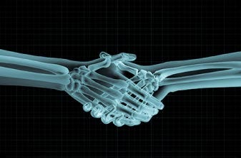
Thank you !

