Slide 1
Determination of lead-210 by the liquid scintillation counting method. Development of radiochemical methods for solid and liquid samples preparation in connection with gross alpha-beta and gamma spectrometry, and XRF methods
Corina Anca Simion¹, Ileana Rǎdulescu¹, Romeo Marian Cǎlin¹, Iulia Ananina² and Dragoş Alexandru Mirea¹
¹Horia Hulubei National Institute for Research & Development in Physics and Nuclear Engineering, NIPNE Magurele Romania
²University of Bucharest, Faculty of Physics Magurele Romania

Slide 2
Introduction / Abstract
Lead-210 determinations at NIPNE Romania are done by liquid scintillation counting (LSC), but also by surface and underground gamma spectrometry (microBq laboratory, Mina Unirea, Slanic-Prahova). Depending on the nature of the samples and the problems raised to be solved, gamma spectrometry won more and more, the method being simple and non-invasive. When the samples raise special problems in obtaining a result with higher accuracy, but also in the interpretation of the obtained values, radiochemical separation and measurement by LSC method will prevail. To respond to the challenges raised by such samples, the laboratory has been refined the methods in use. But it also made contributions regarding the correctness of the final results, the LSC technique being a relative measurement method. The elements of originality on the workflow of radiochemical procedures will be reviewed. Different sources of lead nitrate used as a tracer were investigated for obtaining the best measurement quenched background to which the values obtained for the analytes are related. It is also shown how LSC method can be mutually supported with gross alpha-beta spectrometry, and surface gamma spectrometry. Sometimes XRF method becomes useful in selecting optimal way to find out a reliable source of lead. Some study cases are highlighted.

Slide 3
Topics. An overview of up-to-date researches on 210Pb at NIPNE Romania, using LSC and other measurement techniques
210Pb measurements have been carried out for several decades; first by gamma spectrometry in surface laboratories, then by the liquid scintillation counting method and for 20 years, by high-resolution gamma spectrometry in an underground laboratory.
For each individual situation, the techniques have developed according to the technological opportunities for preparing samples and measurements.
For the liquid scintillation counting (LSC) method, the latest developments of the application are:
separation of 210Pb from water samples and soil-sediment samples, by optimizing the existing pretreatment process;
purification of lead samples of different origins and ages;
improving measurement results by selecting the most appropriate commercial lead nitrate, used as background, or by replacing it with lead nitrate formed from old lead sources.

Slide 4
A more specific description of improvements to the LSC method
1. Development and implementation of improved radiochemical processing methods for:
separation of 210Pb from water and soil-sediment samples; re-evaluation of chemical and radiochemical pretreatment procedures; comparative analysis of different workflow options; criteria for selection and exclusion of samples;
development of purification of lead or lead-based materials of different origins and ages.
2. Development and implementation of measurement methods by beta spectrometry using LSC through:
testing of different sources of lead nitrate used as a carrier and as a background; criteria for choosing best sources of lead nitrate;
establishing the optimal measurement conditions by LSC spectrometry and the possibility of correlating the measurements with gamma / gross alpha-beta spectrometry, and with XRF technique.

Slide 5
Improving the results obtained will be used in:
geochronology;
pedology;
erosion and sedimentation phenomena;
environmental radioactivity;
pollution - impact on the environment;
professional exposures and impact of pollutants on the health of the population.
New directions of exploration:
dating of old habitation horizons (sediment / soil samples);
dating of archaeological lead or lead-based materials;
dating of art objects made of lead or containing lead compounds;
dating of the osteological material, as an alternative method in correlation with radiocarbon dating for the last 110-120 years starting back from measurements moment; nuclear forensic.

Slide 6
Pretreatments
Chemical and radiochemical processing procedures existing or being implemented in the laboratory:
Soil-sediments (presented hereign in connection with a case study):
IAEA procedure, implemented at IFIN-HH / DFVM (Variant A)
Modified procedure, according to PL-URPMB-06 in force (Variant B, validated by international intercomparison exercises)
Optimized chemical pretreatment procedure and standard radiochemical separation procedure; modernization of validated method (Variant C)
Optimized chemical pretreatment and radiochemical separation procedure; modernization of validated procedure (Variant D)

Slide 7
Pretreatments. A brief intercomparison of Variants A, B, C, D
Variant A: according to M. Pimpl, (1996). Determination of 210Pb in Environmental Samples. Standard Operating Procedure. Kernforschungzentrum Karlsruhe, Germany.
Variant B: Variant A, with the replacement of the final analyte precipitation step using oxalic acid and subsequent gravimetric determination of the global process yield, by evaporating the solution directly in the measuring LSC glass vial, forming lead nitrate and determining the global process yield by substracting of empty vial mass.
Variant C: Variant B, with the replacement of chemical disaggregation at normal pressure by disaggregation under pressure (Figure 1, next slide) and use of lead nitrate with minimal lead-210 content, previously tested, as a carrier and for obtaining the background vial for LSC measurements.
Variant D: Variant C and the use of flat water from deep springs, distilled under vacuum, in all stages of radiochemical pretreatments (minimum possible content of beta-minus emitting radionuclides such as tritium, carbon-14, lead-210).

Slide 8
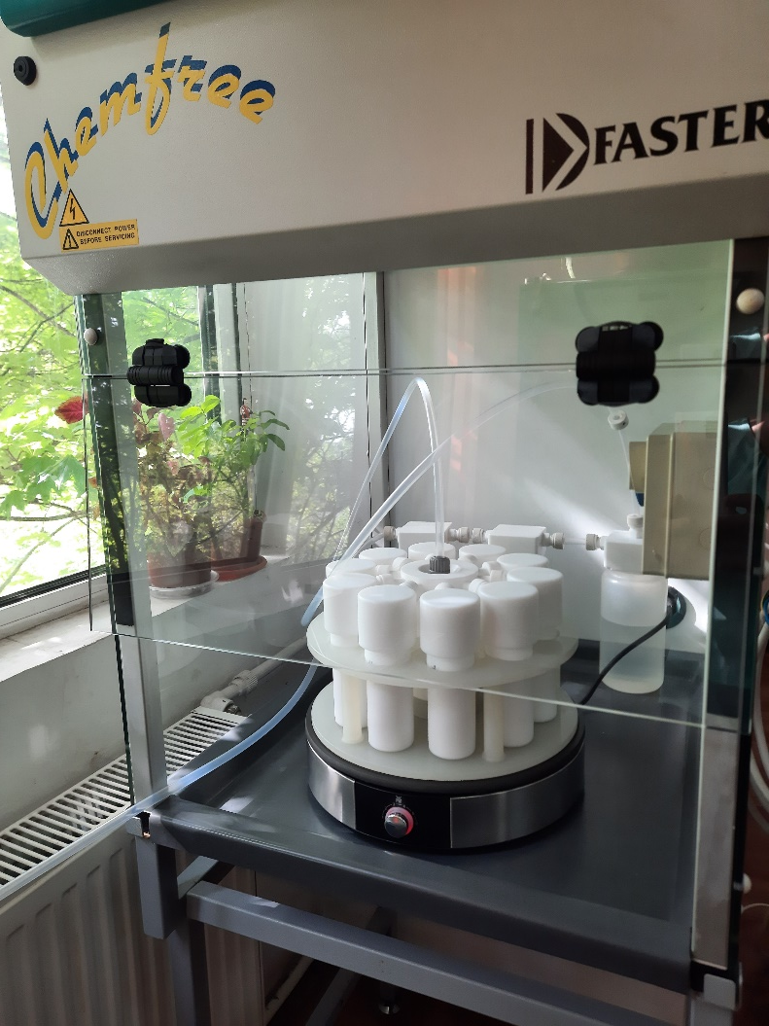
Pretreatments. Variant C; improvements
Figure 1
Disaggregation under pressure of soil-sediment samples
The purpose of pretreatment methods developments (Variant A to Variant D):
Reduction of total analysis time;
Decrease in the consumption of acids and the volume of the resulting chemical waste;
Increasing the global recovery yield of lead nitrate bearing lead-210;
Optimal recovery of the lead-210 fraction using the Sr Resin column from Eichrom Industries.

Slide 9
Overal improvements for soil-sediments sample pretreatments
The use of water with a minimum content of tritium, carbon-14 and lead-210 for the entire analysis chain; waters from deep springs distilled at the rotary evaporator
The use of lead nitrate with the lowest content of lead-210, as a carrier and for obtaining background vials
The use of mineral acids with minimal content or containing no lead in the list of impurities
Obtaining the final analyte, i.e. lead nitrate carrier, directly in the measuring vial, without gravimetric precipitation.

Slide 10
LSC measurement conditions
Tri-Carb 1600TR as analyzer, using quench curve, without internal standard (210Pb solution in equilibrium with descendants)
LD = 0.705 cpm; AMD = 0.084 Bq/mL
The normal measurement mode is used
Mode: CPM
Measurement time: each sample is measured five times for 100 minutes
tSIE measurement: 60 seconds
Measurement window:
A = 2 – 20 keV
B = 20 – 60 keV
C = 0 – 2000 keV

Slide 11
LSC measurements improvement; Table 1
Sample type | A, cpm | B, cpm | Eff | Activity, Bq / mL | Estimated Activity, Bq/g Pb* | Calculated Activity, Bq/g Pb
Recovered lead material ca. 2017 (1) | 17.50 | 6.60 | 0.1373 | 0.645 | 10.75 | 13.22
Recovered lead material ca. 2017 (2) | 15.50 | 6.30 | 0.1395 | 0.416 | 10.41 | 13.22
Pb(NO₃)₂ chemical reagent ca. 2017 | 13.00 | 5.60 | 0.1398 | 0.165 | 8.26 | 13.22
Pb(NO₃)₂ chemical reagent ca. 1977 | 12.30 | 5.50 | 0.1442 | 0.086 | 4.29 | 3.75
Lead pipe fragment ca. 1937 | 11.80 | 5.80 | 0.1384 | 0.008 | 0.43 | 1.06
Old ossuary cover, without textile fragments | 11.60 | 5.40 | 0.1441 | 0.011 | 0.58 | ?
Roman lead fragment | 11.50 | 5.40 | 0.1406 | - | ≅ 0 | 0
Background using high purity HNO₃ 6M in distilled underground water | 11.10 | 5.90 | 0.2500 | - | - | -
*It was extrapolated based on the percentages of lead in the initial sample determined by XRF method, to the equivalent value for 32 mg of lead nitrate; 0.020 g of lead.

Slide 12
Case Study. Determination of radionuclidic content in soil-sediment profiles from Sultana - Malu Rosu, Calarasi county archaeological site
Figure 2. Sultana archaeological site - Malu Rosu, Calarasi, Romania sampling area; the high bank is nowadays an agricultural land with a smooth slope

Slide 13
The gross alpha and gross beta activity concentrations of the archaeological soil samples collected from Sultana – Malu Rosu, Calarasi [Bq/kg]; Table 2
Sample code soil SMR SON 2 BOX A | Total mass [g] | Depth [cm] | Gross α [Bq/kg] | Gross β [Bq/kg]
SP1 | 14.63 | -160/-150 | 6.20±0.52 | 79.30±1.72
SP2 | 15.67 | -150/-140 | 5.06±0.39 | 72.40±3.07
SP3 | 14.48 | -140/-130 | 4.82±0.39 | 78.71±2.53
SP4 | 13.72 | -130/-120 | 10.00±0.97 | 93.73±1.81
SP5 | 13.55 | -120/-110 | 5.89±0.82 | 82.52±2.95
SP6 | 15.45 | -110/-100 | 6.56±2.68 | 73.79±2.28
SP7 | 13.68 | -100/-90 | 6.78±0.72 | 80.31±3.16
SP8 | 12.44 | -90/-80 | 7.33±9.51 | 88.39±3.76
SP9 | 15.64 | -80/-70 | 4.54±0.44 | 72.38±1.81
SP10 | 13.27 | -70/-60 | 7.39±0.39 | 81.92±2.21
SP11 | 15.16 | -60/-50 | 6.02±0.57 | 75.39±2.16
SP12 | 14.07 | -50/-40 | 7.12±0.58 | 78.25±3.03
SP13 | 11.95 | -40/-30 | 7.67±0.53 | 98.72±3.28
SP14 | 15.15 | -30/-20 | 6.78±0.51 | 77.67±2.03
SP15 | 14.42 | -20/-10 | 7.95±0.65 | 83.28±1.70
SP16 | 12.05 | -10/0 | 6.88±0.93 | 90.65±2.51
Mean ± 1σ | 14.08 |  | 6.68±0.52 | 81.11±2.52
Range [Bq/kg] | 11.95-15.45 |  | 4.54±0.44-10.00±0.97 | 72.38±1.81-98.72±3.28
The values ​​with significance in the interpretation of ancient residential horizons have yellow marks

Slide 14
The activity concentrations of 40K, 137Cs, 232Th and 238U progenies of the archaeological soil samples from Sultana – Malu Rosu, Calarasi [Bq/kg]; Table 3.a.
Sample code soil/depth | ²²⁸Ac [Bq/kg] | ²¹²Pb [Bq/kg] | ²⁰⁸Tl [Bq/kg] | ²³⁴Th [Bq/kg] | ²²⁶Ra [Bq/kg]
16 -10/0 | 55.23±6.36 | 58.23±4.97 | 19.14±2.32 | 62.60±4.90 | 41.27±2.47
15 -20/-10 | 51.66±3.63 | 53.88±2.78 | 16.28±1.27 | 60.77±3.00 | 41.62±1.73
14 -30/-20 | 51.04±5.34 | 55.12±4.00 | 17.07±2.23 | 69.62±5.05 | 45.10±2.35
13 -40/-30 | 54.02±4.47 | 52.36±4.00 | 17.09±2.13 | 53.30±3.75 | 44.28±2.50
12 -50/-40 | 54.39±5.79 | 48.60±3.92 | 15.80±1.86 | 58.60±4.00 | 45.94±2.62
11 -60/-50 | 50.34±5.37 | 57.82±3.65 | 16.64±1.66 | 59.00±4.20 | 42.40±2.30
10 -70/-60 | 56.35±5.57 | 56.20±3.64 | 16.00±1.60 | 52.58±3.93 | 49.10±2.80
9 -80/-70 | 55.20±6.02 | 46.80±3.56 | 16.03±1.90 | 60.84±4.37 | 40.12±2.22
8 -90/-80 | 48.24±5.50 | 52.13±4.75 | 16.34±1.71 | 55.62±3.90 | 44.24±2.58
7 -100/-90 | 45.64±3.25 | 50.51±2.85 | 14.27±1.12 | 45.35±2.10 | 37.48±1.58
6 -110/-100 | 54.03±5.70 | 60.00±4.43 | 17.05±2.10 | 59.70±4.00 | 44.67±2.65
5 -120/-110 | 48.85±5.55 | 46.00±4.17 | 15.85±1.80 | 49.60±3.60 | 38.67±2.52
4 -130/-120 | 52.04±5.96 | 52.24±4.72 | 15.95±2.10 | 65.54±5.07 | 38.67±2.42
3 -140/-130 | 51.31±5.07 | 48.08±4.05 | 17.54±2.07 | 49.50±3.20 | 41.58±2.46
2 -150/-140 | 49.38±3.58 | 51.34±2.86 | 14.90±1.27 | 49.64±2.40 | 41.77±1.73
1 -160/-150 | 50.60±4.64 | 51.11±3.33 | 17.27±2.10 | 52.70±3.35 | 44.26±2.63

Slide 15
The activity concentrations of 40K, 137Cs, 232Th and 238U progenies of the archaeological soil samples from Sultana – Malu Rosu, Calarasi [Bq/kg]; Table 3.b.
Sample code soil/depth | ²¹⁴Pb [Bq/kg] | ²¹⁴Bi [Bq/kg] | ²¹⁰Pb [Bq/kg] | ¹³⁷Cs [Bq/kg] | ⁴⁰K [Bq/kg]
16 -10/0 | 36.53±2.30 | 39.50±4.00 | 53.41±15.13 | 22.35±0.94 | 695.25±22.16
15 -20/-10 | 36.86±1.26 | 40.50±3.27 | 26.30±5.16 | 13.85±0.51 | 669.30±20.43
14 -30/-20 | 35.24±1.48 | 36.30±4.62 | 43.15±8.50 | 1.50±0.26 | 660.20±20.86
13 -40/-30 | 35.80±1.50 | 39.63±3.54 | MDA | MDA | 672.77±21.27
12 -50/-40 | 34.10±1.40 | 36.60±4.96 | MDA | MDA | 680.10±21.45
11 -60/-50 | 33.33±1.40 | 33.18±1.62 | MDA | MDA | 644.60±20.43
10 -70/-60 | 35.48±1.46 | 36.56±4.37 | MDA | MDA | 650.54±20.60
9 -80/-70 | 38.67±1.62 | 42.87±5.27 | MDA | MDA | 649.16±20.60
8 -90/-80 | 43.10±1.64 | 39.65±5.10 | 65.26±12.30 | MDA | 620.84±19.64
7 -100/-90 | 39.25±1.30 | 39.85±3.10 | MDA | MDA | 602.72±18.40
6 -110/-100 | 41.70±1.68 | 45.08±5.83 | 34.80±6.52 | MDA | 631.96±20.06
5 -120/-110 | 34.36±1.46 | 31.39±4.54 | 54.72±14.13 | MDA | 594.54±18.87
4 -130/-120 | 41.57±1.63 | 45.57±4.80 | MDA | MDA | 620.10±19.62
3 -140/-130 | 36.97±1.48 | 37.30±4.02 | MDA | MDA | 616.07±19.50
2 -150/-140 | 38.92±1.33 | 39.87±3.28 | MDA | MDA | 640.00±19.56
1 -160/-150 | 42.58±1.62 | 44.10±4.64 | MDA | MDA | 622.67±19.55
MDA =
Minimum Detectable Activity

Slide 16
The activity concentrations of 210Pb; intercomparison of gamma spectrometry results with LSC results, in conjunction with 40K results [Bq/kg]; Table 4
Sample code soil/depth | ²¹⁰Pb [Bq/kg] gamma | ²¹⁰Pb [Bq/kg] LSC
16; -10/0 | 53.41 ± 15.13 | 46.26 ± 2.91
15; -20/-10 | 26.30 ± 5.16 | 17.95 ± 2.58
14; -30/-20 | 43.15 ± 8.50 | 37.15 ± 2.72
13; -40/-30 | MDA | 38.61 ± 2.80
12; -50/-40 | MDA | 32.34 ± 2.97
11; -60/-50 | MDA | 34.05 ± 2.94
10; -70/-60 | MDA | 34.71 ± 2.97
9; -80/-70 | MDA | 38.87 ± 2.78
8; -90/-80 | 65.26 ± 12.30 | 46.07 ± 2.92
7; -100/-90 | MDA | 32.60 ± 2.98
6; -110/-100 | 34.80 ± 6.52 | 26.67 ± 2.71
5; -120/-110 | 54.72 ± 14.13 | 39.00 ± 2.75
4; -130/-120 | MDA | 35.11 ± 2.88
3; -140/-130 | MDA | 32.07 ± 3.00
2; -150/-140 | MDA | 38.41 ± 2.81
1; -160/-150 | MDA | 26.47 ± 2.73
⁴⁰K [Bq/kg]
695.25 ± 22.16
669.30 ± 20.43
660.20 ± 20.86
672.77 ± 21.27
680.10 ± 21.45
644.60 ± 20.43
650.54 ± 20.60
649.16 ± 20.60
620.84 ± 19.64
602.72 ± 18.40
631.96 ± 20.06
594.54 ± 18.87
620.10 ± 19.62
616.07 ± 19.50
640.00 ± 19.56
622.67 ± 19.55
The correlation factor
between the series of
values ​​obtained for 210Pb was 94%; the values ​​are very well correlated

Slide 17
Correlations between the maxima concentrations of radioisotopes of interest, useful for an archaeological interpretation
Series of data for gross alpha-beta are correlated each other for older horizons, suggesting past events that can be traced through 40K and 210Pb in conjunction with 226Ra; they are distinct only for recent up to -30 cm depth
137Cs: post-Chernobyl anthropogenic deposition with a normal distribution and a sedimentation rate specific to the soils in this region in the first 30 cm
40K: horizons of human habitation in the past, with anthropogenic deposits, or past natural events that involved large vegetation fires
210Pb: anthropogenic levels with disturbance of the natural stratigraphy of the soil and / or important natural events such as earthquakes, landslides with sediment post-deposits

Slide 18
Preliminary conclusions and further developments of the study case
Analyzing and superimposing the maximum values ​​for all radioisotopes of interest suggests anthropogenic changes or natural events placed at -150 cm, at -130 / -120 cm, at -80 / -70 cm and at -40 cm, towards current elevation of the land.
The layers rich in 40K, to mark the anthropic presence in conjunction with the archaeological discoveries, can be tested in a later stage by determining the mass percentage of carbon and nitrogen and by radiocarbon dating.
The results so far obtained for 210Pb by gamma spectrometry at a surface laboratory and by LSC spectrometry, beyond the novelties briefly listed in this presentation, are worth to be compared with those obtained by high-resolution gamma spectrometry at the microBq underground laboratory from Slanic-Prahova Romania.

